Slide 1
19L038 – DEEP LEARNING
DYNAMIC TRAFFIC CONTROL
SARRANADHITHIYAA G
22L262

Slide 2
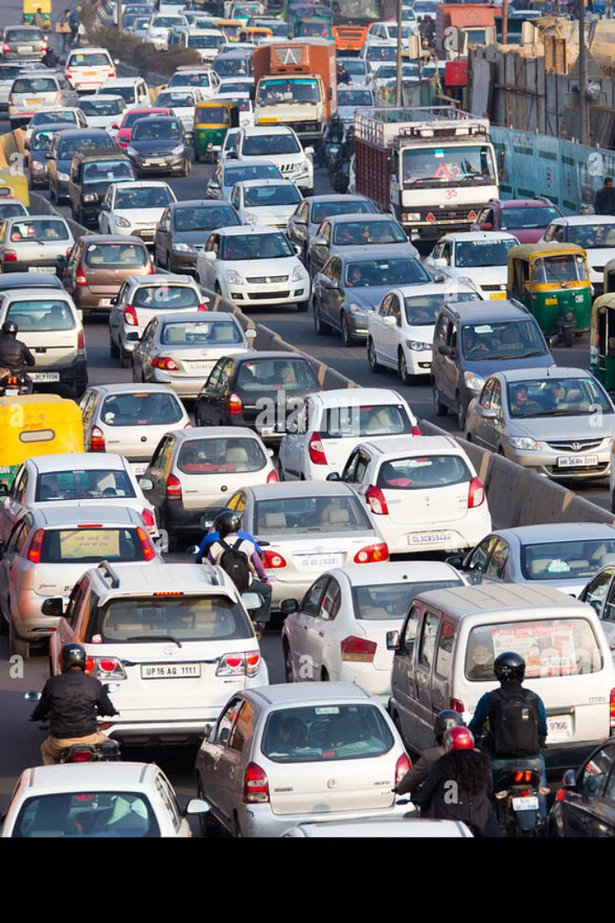
Addressing Traffic Congestion with Smart Systems
Traffic Congestion Challenges
Manual Traffic Monitoring
Current traffic systems face difficulties due to unbalanced signal timings, resulting in delays and overall inefficiency. This congestion leads to increased travel times and fuel consumption.
Traditional manual traffic monitoring is time-consuming, prone to errors, and often lacks the real-time responsiveness needed to address rapidly changing traffic conditions.
Dynamic System Objective
The objective is to develop a dynamic system that automatically adjusts traffic signal durations based on real-time vehicle counts, optimizing traffic flow and reducing congestion.

Slide 3
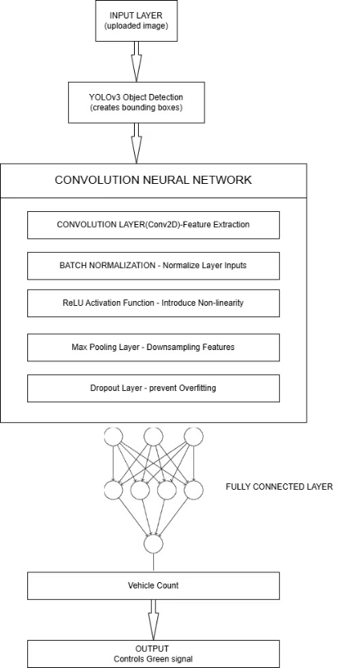
Implementation of Real-Time Traffic Management
The integration of these components enables robust and adaptive traffic management capabilities.

Slide 4



Data Preprocessing for Deep Learning Models
CNN Preprocessing
Images resized to 128x128 pixels for uniform input.
Pixel values normalized to the range [0, 1].
Data Augmentation
Random rotation to simulate varied perspectives.
Brightness adjustment to handle different lighting conditions.
Flipping and zooming to increase dataset variability.
YOLOv3 Preprocessing
Blob creation from frames for real-time object detection, allowing efficient processing of video streams.

Slide 5
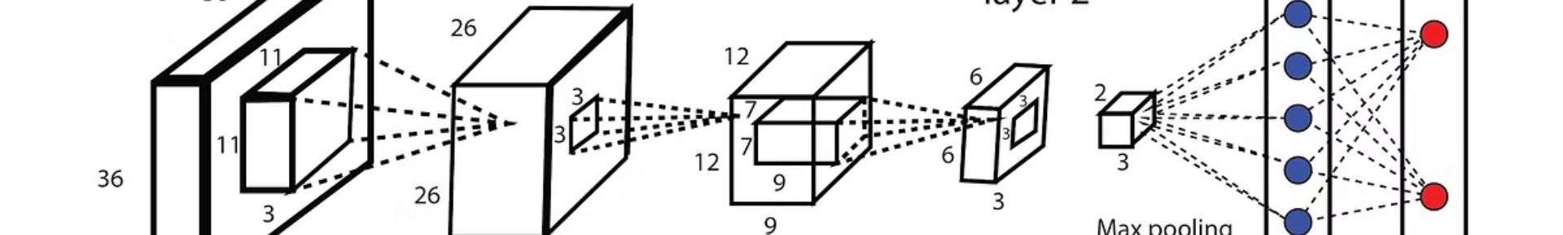
CNN Architecture for Vehicle Classification
Convolutional Layers
1
Three convolutional layers with 32, 64, and 128 filters extract features from vehicle images, enabling robust classification.
2
Fully Connected Layers
Fully connected dense layers with ReLU activation classify images into categories like cars, trucks, buses, and motorbikes, providing granular vehicle type information.
YOLO Integration
3
YOLO detects vehicles and provides bounding boxes, while the CNN model processes detected vehicle regions and integrates vehicle classification results, providing comprehensive data.
4
Traffic Light Adjustment
CNN enables counting vehicles and triggering traffic light adjustments, dynamically optimizing traffic flow based on real-time conditions and responsiveness.

Slide 6
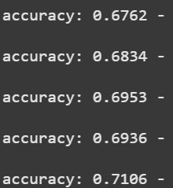
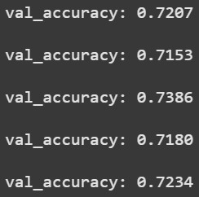
Performance Analysis of the Integrated System
CNN Model
YOLOv3 Integration
The Convolutional Neural Network (CNN) model is pivotal in classifying vehicles, allowing for accurate categorization into cars, trucks, buses, or motorbikes. This classification is crucial for effective traffic management.
YOLOv3 integration ensures robust object detection with a detection threshold set at a confidence level greater than 40%. This threshold optimizes detection accuracy while minimizing false positives, improving overall traffic monitoring.

Slide 7
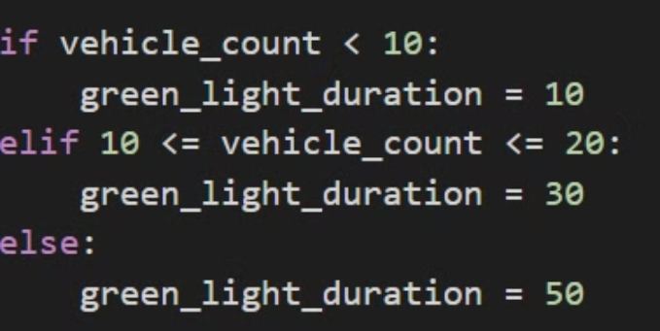



Dynamic Traffic Signal Adjustment Mechanism
Density Analysis
2
Analyze vehicle density and traffic patterns at the intersection and responsiveness.
Real-time Data
1
Gather real-time vehicle counts and classification data from YOLOv3 and the CNN.
Signal Adjustment
Dynamically adjust green light duration based on vehicle density to optimize traffic flow.
3
This dynamic adjustment mechanism optimizes traffic flow and reduces congestion.

Slide 8
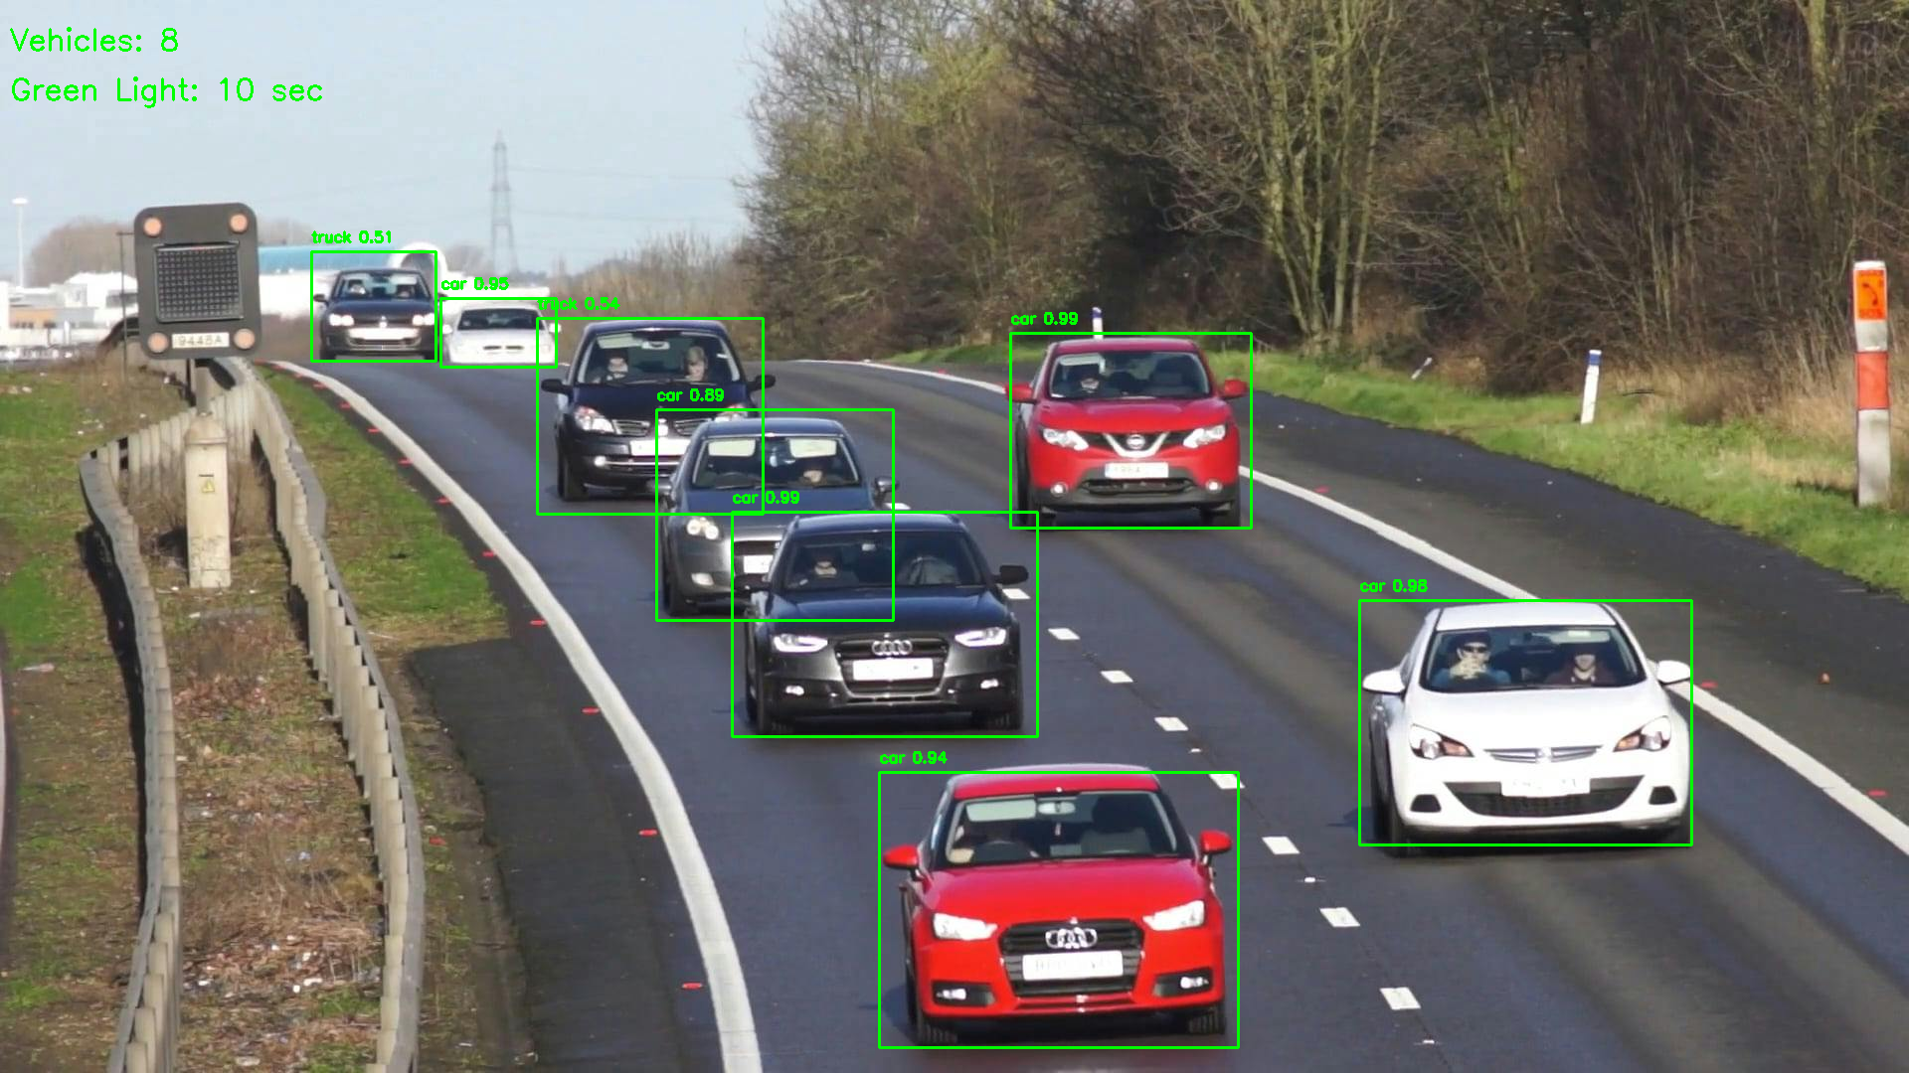



System Output and Traffic Flow Optimization
Optimized Flow
Reduced Delays
Adaptive Signals
Enhance traffic flow efficiency by dynamically adjusting signal timings.
Minimize vehicle delays and congestion at intersections in real time.
Provide real-time adaptability to changing traffic conditions for responsiveness.

Slide 9

Conclusion
Dynamic Adjustment
CNN Classification
Dynamically adjust green light duration based on vehicle density to improve traffic flow efficiency and responsiveness.
YOLOv3 Detection
Employ CNN classification for accurate vehicle counting and categorization.
Utilize YOLOv3 for robust vehicle detection in diverse conditions.
The system demonstrates the synergy between object detection and machine learning in solving real-world problems, paving the way for smarter and more efficient urban traffic management, congestion, and responsiveness.

